Slide 1


Students With Disabilities
|
IN SAUDI ARABIA
By : Ghaida Ali Alaqeel
Instructor : Dr. Mejdal Alqahtani

Slide 2
TABLE OF CONTENTS
01
02
03
04
InTRODUCTION
data
questions
CONCLUSION

Slide 3
Introduction
The human spirit is one of ability, perseverance and courage that no disability can steal away.

Slide 4
GOAL!
My Goal project is to help the Human Resources and Social Development Authority to prepare and develop this people case to use of them in suitable places

Slide 5
Data gathering
Data set
From openData.com
Prepared in Saudi Arabia
By ‘ Human Resources and Social Development Authority ’
in 1442 hijri

Slide 6
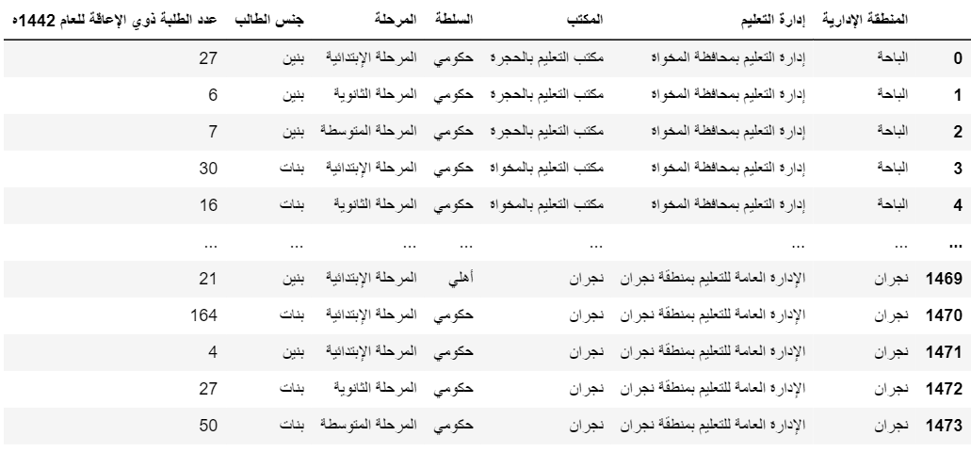
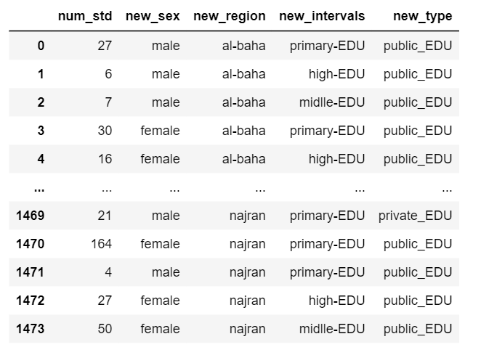
Data set

Slide 7
Questions !
I have some question and I analysis and explored my data to find the solutions.

Slide 8
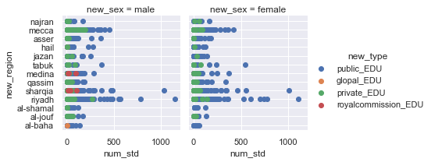
Q1 : What the school types of female and male ‘ Disabled Students ’

Slide 9
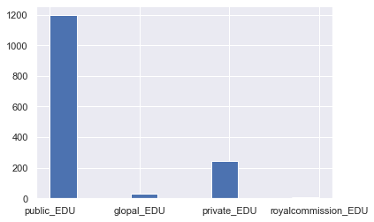
Q1 : What the school types of female and male ‘ Disabled Students ’
Count number of ‘ Disabled Students ’

Slide 10
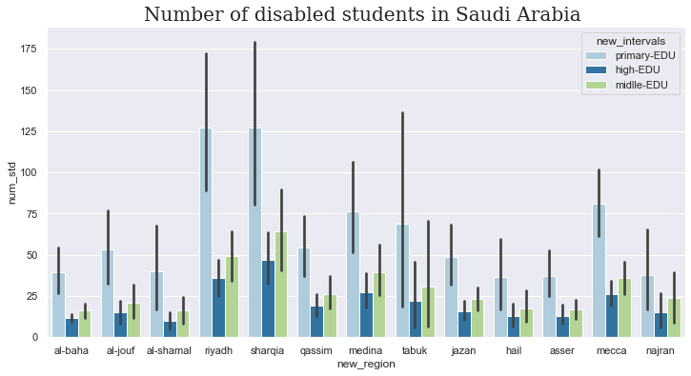
Q2 : What is the interval types and the most city ‘ Disabled Students ’

Slide 11
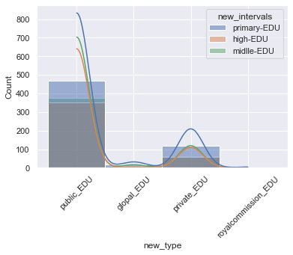
Q2 : What is the interval type and the most city ‘ Disabled Students ’

Slide 12
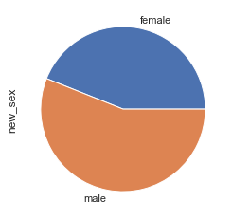
Q3 : What is the number of female and male with disabled
female
43%
male
56%

Slide 13
Conclusion and future work
◦ Disparity of students number in all intervals
◦ Most common of the cities and different types of schools
◦ My opinion to future :
prepare teams and places to develop the gradate students
Adoption and collect talents

